Slide 1
Encryption
Data in its default format is known as ‘plaintext’
Vulnerable to unauthorized access over a network
Encryption mechanisms used to protect the confidentiality and integrity of data, encoding plaintext into a protected and unreadable format known as ‘ciphertext’
An ‘encryption key’ is also used as input to the encryption mechanism to make the encryption unique and control who can decrypt the ciphertext, returning it to plaintext
Two basic approaches:
Symmetric Encryption, also known as secret key cryptography, uses the same/shared key to encrypt and decrypt the data
Asymmetric Encryption, also known as public key cryptography, uses different keys to encrypt and decrypt the data
Describe cloud technologies and how they are used to construct cloud computing solutions;
Describe how cloud computing is used to solve computing problems;
Compare equivalent cloud-based and non-cloud solutions to highlight their characteristics

Slide 2
substitution cipher To encode some text, simply find each character in the text in the first line, and replace it by the character below it.
A | B | C | D | E | F | G | H | I | J | K | L | M | N | O | P | Q | R | S | T | U | V | W | X | Y | Z
R | Z | B | U | Q | K | F | C | P | Y | E | V | L | S | N | G | W | O | X | D | J | I | A | H | T | M
“Hello” you get “CQVVN” ``BIRDBRAIN'', you get ``ZPOUZORPS''.
Notes:
Authority revocation list (ARL) - A separate revocation list is maintained for CA keys that have been compromised or should no longer be trusted.
CA certificate – The certificate belonging to a certificate authority
Certificate – A cryptographically signed object that contains an identity and a public key associated with this identity. The certificate can be used to establish identity, analogous to a notarized written document.
Certificate authority (CA) – An entity responsible for issuing and revoking certificates. Cas are typically not associated with the company requiring the certificate, although they exist for internal company use as well (such as Microsoft). This term is also applied to server software that provides these services. The term certificate authority is used interchangeably with certification authority.
Certificate path – The validation path a certificate takes from CA to CA until it reaches the shared trusted anchor.
Certificate repository - Is a general term that describes a centralized directory that can be accessed by a subset of individuals.
Certificate revocation list (CRL) - A list of serial numbers of certificates that have been revoked
Certificate server - Is the actual service that issues certificates based on the data provided during the initial registration process.
Certification practices statement (CPS) - The CPS along with the CA determines the frequency with which the CRL is updated
Cross-certificate - Is used when independent CAs establish peer-to-peer trust relationships.
Digital certificate - A cryptographically signed object that contains an identity and a public key associated with this identity. The certificate can be used to establish identity, analogous to a notarized written document.
dual control - Two people have to be present to carry out a specific task.
end-entity certificates - AN end-entity certificate is the identity document provided by PKI implementations.
hierarchical trust model - Is a basic hierarchical structure that contains a root CA, intermediate CAs, leaf CAs, and end-entities.
hybrid trust model - In a hybrid trust model, the two companies have their own internal hierarchical models and are connected through a peer-to-peer model using cross-certification.
key archiving system - Is a way of backing up keys and securely storing them in a repository
key escrow - Is the process of giving keys to a third party so that they can decrypt and read sensitive information if the need arises.
key recovery - Is a process that allows for lost keys to be recovered.
local registration authority (LRA) - Performs the same functions as an RA, but the LRA is closer to the end users.
Online Certificate Status Protocol (OCSP) - A request and response protocol that obtains the serial number of the certificate that is being validated and reviews revocation lists for the client.
peer-to-peer trust model - One CA is not subordinate to another CA, and no established trusted anchor between the CAs is involved.
policy certificate – The mechanism used to provide centrally controlled policy information to PKI clients.
public key infrastructure (PKI) – Infrastructure for binding a pubic key to a known user though a trusted intermediary, typically a certificate authority.
registration authority (RA) - Is the PKI component that accepts a request for a digital certificate and performs the necessary steps of registering and authenticating the person requesting the certificate.

Slide 3
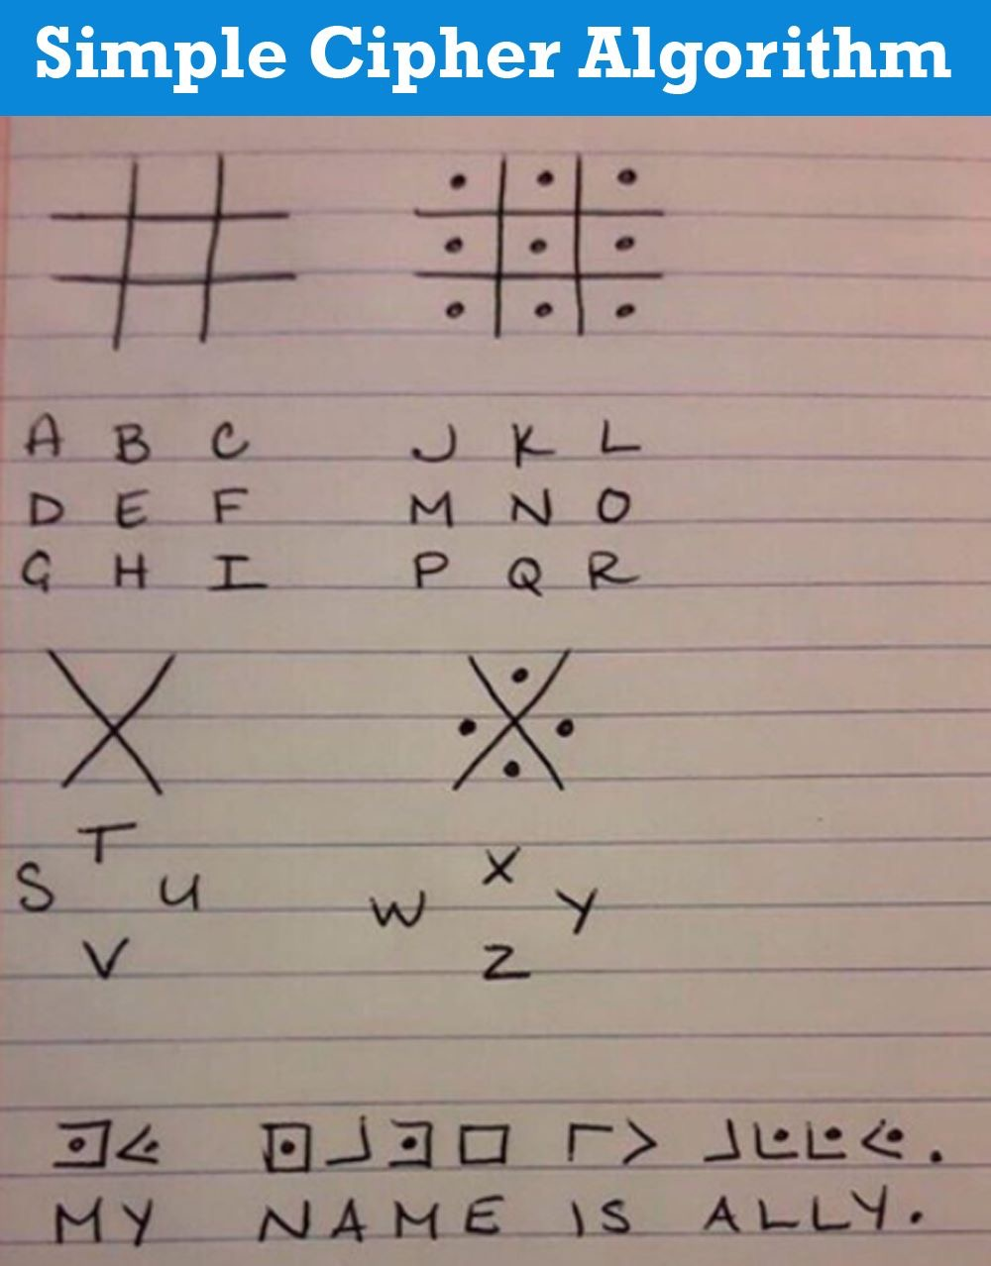
Notes:
Authority revocation list (ARL) - A separate revocation list is maintained for CA keys that have been compromised or should no longer be trusted.
CA certificate – The certificate belonging to a certificate authority
Certificate – A cryptographically signed object that contains an identity and a public key associated with this identity. The certificate can be used to establish identity, analogous to a notarized written document.
Certificate authority (CA) – An entity responsible for issuing and revoking certificates. Cas are typically not associated with the company requiring the certificate, although they exist for internal company use as well (such as Microsoft). This term is also applied to server software that provides these services. The term certificate authority is used interchangeably with certification authority.
Certificate path – The validation path a certificate takes from CA to CA until it reaches the shared trusted anchor.
Certificate repository - Is a general term that describes a centralized directory that can be accessed by a subset of individuals.
Certificate revocation list (CRL) - A list of serial numbers of certificates that have been revoked
Certificate server - Is the actual service that issues certificates based on the data provided during the initial registration process.
Certification practices statement (CPS) - The CPS along with the CA determines the frequency with which the CRL is updated
Cross-certificate - Is used when independent CAs establish peer-to-peer trust relationships.
Digital certificate - A cryptographically signed object that contains an identity and a public key associated with this identity. The certificate can be used to establish identity, analogous to a notarized written document.
dual control - Two people have to be present to carry out a specific task.
end-entity certificates - AN end-entity certificate is the identity document provided by PKI implementations.
hierarchical trust model - Is a basic hierarchical structure that contains a root CA, intermediate CAs, leaf CAs, and end-entities.
hybrid trust model - In a hybrid trust model, the two companies have their own internal hierarchical models and are connected through a peer-to-peer model using cross-certification.
key archiving system - Is a way of backing up keys and securely storing them in a repository
key escrow - Is the process of giving keys to a third party so that they can decrypt and read sensitive information if the need arises.
key recovery - Is a process that allows for lost keys to be recovered.
local registration authority (LRA) - Performs the same functions as an RA, but the LRA is closer to the end users.
Online Certificate Status Protocol (OCSP) - A request and response protocol that obtains the serial number of the certificate that is being validated and reviews revocation lists for the client.
peer-to-peer trust model - One CA is not subordinate to another CA, and no established trusted anchor between the CAs is involved.
policy certificate – The mechanism used to provide centrally controlled policy information to PKI clients.
public key infrastructure (PKI) – Infrastructure for binding a pubic key to a known user though a trusted intermediary, typically a certificate authority.
registration authority (RA) - Is the PKI component that accepts a request for a digital certificate and performs the necessary steps of registering and authenticating the person requesting the certificate.

Slide 4
Encryption
Key features of asymmetric encryption:
Two keys:
Public key: sent to other communicating party/parties
Private key: kept secret by one party (the owner)
Data encrypted with one key can only be decrypted using the matching key
Encrypt with public key, only the owner can decrypt (confidentiality)
Encrypt with the private key, anyone with public key can decrypt, but proves the owner sent the message
Provides integrity, authenticity and non-repudiation
Slower than symmetric encryption
Describe cloud technologies and how they are used to construct cloud computing solutions;
Describe how cloud computing is used to solve computing problems;
Compare equivalent cloud-based and non-cloud solutions to highlight their characteristics

Slide 5
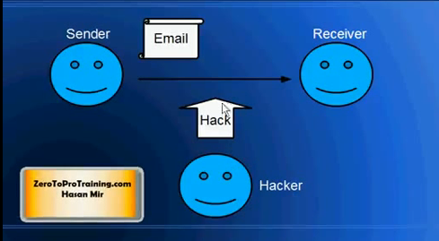
Symmetric and Asymmetric (public-key cryptography) Encryption Overview
http://www.youtube.com/watch?v=EJd8zqN3zTw
Notes:
Authority revocation list (ARL) - A separate revocation list is maintained for CA keys that have been compromised or should no longer be trusted.
CA certificate – The certificate belonging to a certificate authority
Certificate – A cryptographically signed object that contains an identity and a public key associated with this identity. The certificate can be used to establish identity, analogous to a notarized written document.
Certificate authority (CA) – An entity responsible for issuing and revoking certificates. Cas are typically not associated with the company requiring the certificate, although they exist for internal company use as well (such as Microsoft). This term is also applied to server software that provides these services. The term certificate authority is used interchangeably with certification authority.
Certificate path – The validation path a certificate takes from CA to CA until it reaches the shared trusted anchor.
Certificate repository - Is a general term that describes a centralized directory that can be accessed by a subset of individuals.
Certificate revocation list (CRL) - A list of serial numbers of certificates that have been revoked
Certificate server - Is the actual service that issues certificates based on the data provided during the initial registration process.
Certification practices statement (CPS) - The CPS along with the CA determines the frequency with which the CRL is updated
Cross-certificate - Is used when independent CAs establish peer-to-peer trust relationships.
Digital certificate - A cryptographically signed object that contains an identity and a public key associated with this identity. The certificate can be used to establish identity, analogous to a notarized written document.
dual control - Two people have to be present to carry out a specific task.
end-entity certificates - AN end-entity certificate is the identity document provided by PKI implementations.
hierarchical trust model - Is a basic hierarchical structure that contains a root CA, intermediate CAs, leaf CAs, and end-entities.
hybrid trust model - In a hybrid trust model, the two companies have their own internal hierarchical models and are connected through a peer-to-peer model using cross-certification.
key archiving system - Is a way of backing up keys and securely storing them in a repository
key escrow - Is the process of giving keys to a third party so that they can decrypt and read sensitive information if the need arises.
key recovery - Is a process that allows for lost keys to be recovered.
local registration authority (LRA) - Performs the same functions as an RA, but the LRA is closer to the end users.
Online Certificate Status Protocol (OCSP) - A request and response protocol that obtains the serial number of the certificate that is being validated and reviews revocation lists for the client.
peer-to-peer trust model - One CA is not subordinate to another CA, and no established trusted anchor between the CAs is involved.
policy certificate – The mechanism used to provide centrally controlled policy information to PKI clients.
public key infrastructure (PKI) – Infrastructure for binding a pubic key to a known user though a trusted intermediary, typically a certificate authority.
registration authority (RA) - Is the PKI component that accepts a request for a digital certificate and performs the necessary steps of registering and authenticating the person requesting the certificate.

Slide 6
Hashing
Hashing functions are commonly used encryption methods.
One-way, non-reversible form of data protection, i.e., cannot determine the original data from the hash
Commonly used for storing passwords, i.e., the password isn’t stored, the hash of the password is.
Can be used to create a message digest, i.e., fixed length hashing code that can be attached to the message and verified by the receiver
Any change to the original data will result in a different message digest and clearly indicates tampering
Describe cloud technologies and how they are used to construct cloud computing solutions;
Describe how cloud computing is used to solve computing problems;
Compare equivalent cloud-based and non-cloud solutions to highlight their characteristics

Slide 7
Hashing
Hashing functions are used to
Store computer passwords
Ensure message integrity
Hashing steps
Create a file.
Get its hash value.
Send the file and the hash to someone.
They can run the file and get it hash value as well.
If the hashes match, the file is in complete tact.
http://www.fileformat.info/tool/hash.htm
Describe cloud technologies and how they are used to construct cloud computing solutions;
Describe how cloud computing is used to solve computing problems;
Compare equivalent cloud-based and non-cloud solutions to highlight their characteristics

Slide 8
Public Key Infrastructure (PKI)
A system of protocols, data formats, rules, and practices for managing the asymmetric keys
Associates public keys with key owners (public key identification) and enables verification of key validity
Rely on the use of digital certificates
Digitally signed data structures binding public keys to certificate owner identities
Usually digitally signed by a third-party certificate authority (CA)
Only a handful of trusted CAs, e.g., VeriSign, Comodo
Describe cloud technologies and how they are used to construct cloud computing solutions;
Describe how cloud computing is used to solve computing problems;
Compare equivalent cloud-based and non-cloud solutions to highlight their characteristics

Slide 9
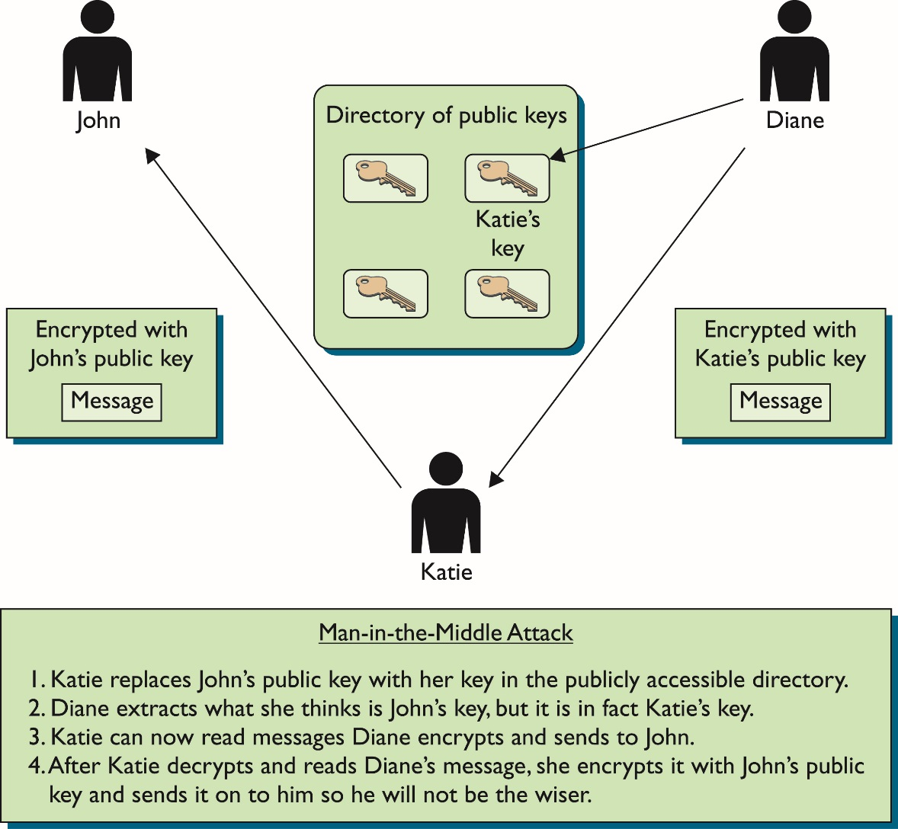
Can You Trust That Key?
Notes:
PKI boils down to establishing a level of trust.
Public key encryption is a great way to secure the confidentiality of your information. However it is dependent upon having the correct public key!
If the keys are publically stored and managed, who is checking to see if the keys actually belong to who they say they do?
Who is making sure they are not swapped?
If, for example, John and Diane want to communicate securely, John can generate his own public/private key pair and send his public key to Diane, or he can place his public key in a directory that is available to everyone.
If Diane receives John’s public key, either from him or from a public directory, how does she know the key really came from John?
Maybe another individual, Katie, is masquerading as John and has replaced John’s public key with her own, (referred to as a man-in-the-middle attack).
If this took place, Diane would believe that her messages could be read only by John and that the replies were actually from him.
However, she would actually be communicating with Katie.
What is needed is a way to verify an individual’s identity, to ensure that a person’s public key is bound to their identity and thus ensure that the previous scenario (and others) cannot take place.

Slide 10
Basics of Public Key Infrastructures
PKI environments use entities called registration authorities (RAs) and certificate authorities (CAs).
PKIs work like the DMV (Department of Motor Vehicles).
You prove you who you are to the DMV by bringing the information they require.
If yzxb, re zou have met the requirements, you are issued an Identification card.
When people ask you who you are, you show the ID from the DMV.
They should now believe you are who you say you are.
PKI helps prevent a man-in-the-middle attack.
Notes:
PKI works like the DMV (Department of Motor Vehicles).
When John goes to register for a driver’s license, he has to prove his identity to the DMV by providing his passport, birth certificate, or other identification documentation.
If the DMV is satisfied with the proof John provides (and John passes a driving test), the DMV will create a driver’s license that can then be used by John to prove his identity.
Whenever John needs to identify himself, he can show his driver’s license.
Although many people may not trust John to identify himself truthfully, they do trust the third party, the DMV.

Slide 11
Digital Signature
Provides data authenticity and integrity through authentication.
A message is assigned a digital signature prior to transmission, which is then rendered invalid if the message experiences any unauthorized modifications.
A digital signature provides evidence that the message received is the same as the one created by its rightful sender.
Both hashing and encryption are involved in the creation of a digital signature
Message is assigned a digital signature prior to transmission which is rendered invalid if any unauthorised modifications are made
Describe cloud technologies and how they are used to construct cloud computing solutions;
Describe how cloud computing is used to solve computing problems;
Compare equivalent cloud-based and non-cloud solutions to highlight their characteristics

Slide 12
Identity and Access Management (IAM)
Encompasses components and policies to control and track user identities and privileges
Authentication: checking users are who they claim to be, most commonly username and password, but can also support digital signatures, digital certificates, biometrics, specialised software such as voice analysis, and locking user accounts to registered network addresses (IP or MAC)
Authorization: defines granularity for access controls and oversees relationships between identities, access control rights, and IT resource availability
User Management: creation of new user identifies, access groups, resetting passwords, password policies, and managing privileges
Credential Management: establishes identities and access control rules for defined user accounts, mitigating insufficient authorization
Describe cloud technologies and how they are used to construct cloud computing solutions;
Describe how cloud computing is used to solve computing problems;
Compare equivalent cloud-based and non-cloud solutions to highlight their characteristics

Slide 13
Single Sign-On (SSO)
One password for a user is shared between many services.
Enables cloud service consumer to be authenticated by a security broker
Establishes security context that is persisted while the cloud service consumer accesses other cloud services or cloud-based IT resources
Without SSO would require cloud service consumer to re-authenticate for every request
Describe cloud technologies and how they are used to construct cloud computing solutions;
Describe how cloud computing is used to solve computing problems;
Compare equivalent cloud-based and non-cloud solutions to highlight their characteristics
Notes:
A common usage of LDAP is to provide a "single sign-on" where one password for a user is shared between many services, such as applying a company login code to web pages (so that staff log in only once to company computers, and then are automatically logged into the company intranet)

Slide 14
API-Application Programming Interface
API is a messenger who’s take your request and tell the system what you want to do and then return the response back to you (Like a waiter in a restaurant).
API used to connect different services to each other. If you build your own App and you need to provide access to Facebook or twitter from your App then you will need to use Facebook and twitter API’s to connect your APP with them. In this case you can increase your App functionality.
We use API in case we have no direct access to the web service. Like when we book a hotel room from www.booking.com (Not directly from the hotel website). www.booking.com communicate with the hotels web sites through API’s.
Describe cloud technologies and how they are used to construct cloud computing solutions;
Describe how cloud computing is used to solve computing problems;
Compare equivalent cloud-based and non-cloud solutions to highlight their characteristics
Notes:
AIP (Application Programming Interface) https://www.youtube.com/watch?v=B9vPoCOP7oY
Connect different services to each other. If you build your own APP and you need to provide access to Facebook or twitter from your APP then you will need to use Facebook and twitter API’s to connect your APP with them.in this case you can increase your APP functionality.
API is a messenger who’s take your request and tell the system what you want to do and then return the response back to you (Like a waiter in a restaurant).
We use API in case we have no direct access to the web service. Like when we book a hotel room from booking.com (Not directly from the hotel website)
Booking.com communicate with the hotels we sites through API’s.

